Slide 1
Software Cluster Project Part 1
Foodview

Slide 3

List of Items:
Site Navigation Diagram
Write-up of web application’s functionalities
Low Fidelity Prototype (Wireframes)
References

Slide 4
Site Navigation Map
Home
Catalogue
Login
Restaurants review popup
Sign Up
Login
Catalogue
Home
View Review
Account
Catalogue
View my review
Add/edit my review
Add/edit my review

Slide 5

Functionalities of Web Application
User can do CRUD, sorting and searching on their review after their login
User can choose to edit account details after their login.
User can choose to delete account permanently after their login
user reset username and password after their login
Sort and categorize the restaurants (After and before login)
User can search for restaurants (After and before login)
User have multiple options to login
Enable user to login
User can view restaurant detail and comments about the restaurants

Slide 6
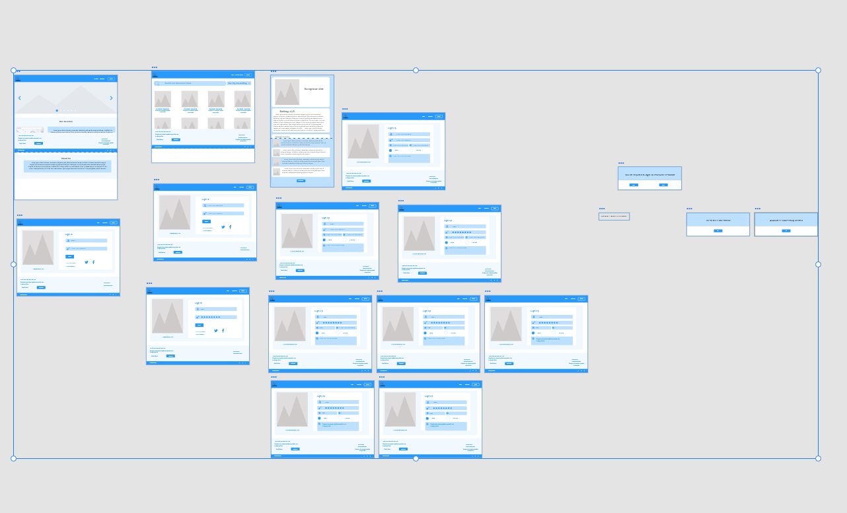
Wireframes

Slide 7
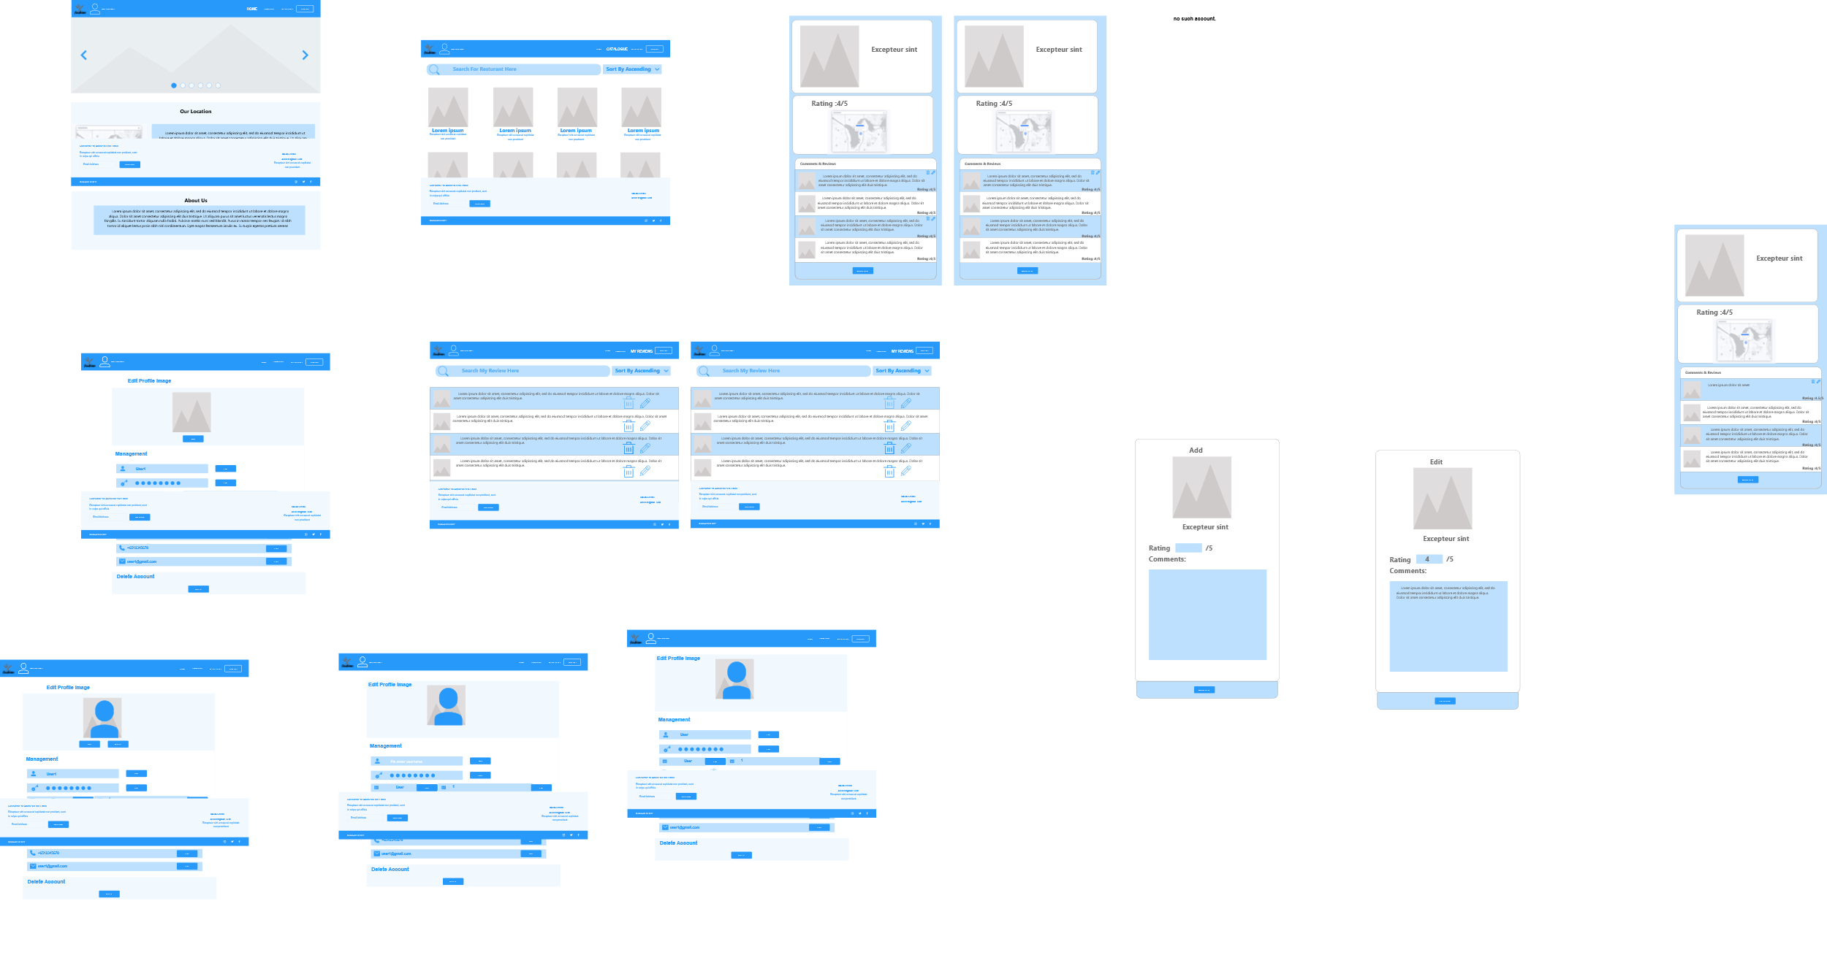
Wireframes

Slide 8
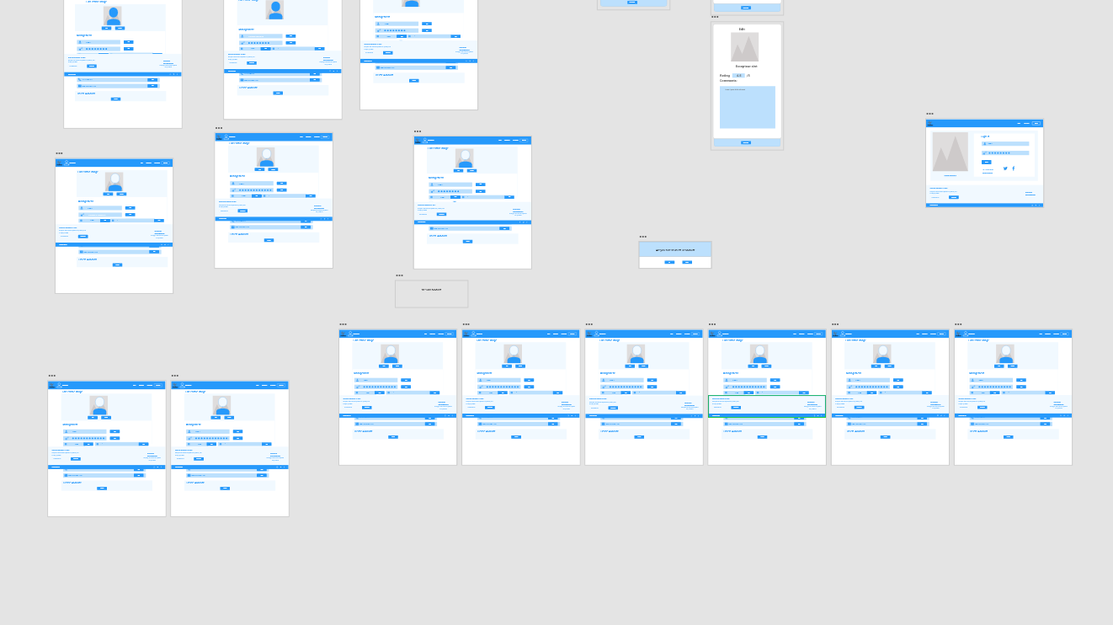
Wireframes

Slide 9
References
https://nucleoapp.com/ - icons
https://www.behance.net/gallery/55462459/Wires-wireframe-kits-for-Adobe-XD - templates

Slide 10
Live Demo of the prototype
https://drive.google.com/file/d/11Uiz9_ABqSqXKB2qULTSub1IKXgnr1bl/view?usp=sharing

